Slide 1
Road Maintenance Complaint System
Mid-Term Report Presentation
Aashutosh Sapkota
Hom Bdr. Pathak Kshetri
Abhishek Sharma
Rajeev Paudel

Slide 2
INTRODUCTION

Slide 3
1.1 Background:
Road accidents are a significant concern due to inadequate road maintenance.
Poor road conditions contribute to accidents, injuries, and loss of life.
Existing systems lack an efficient mechanism to address road-related complaints.
Our system aims to address this issue by providing a platform for reporting road conditions and maintenance needs.
By empowering citizens to actively participate, we can contribute to safer and well-maintained roads.

Slide 4
1.2 Problem Statement
1. Poor road maintenance and inadequate infrastructure in Nepal.
2. Absence of a dedicated governing body or mechanism to address road-related issues.
3. Limited government budget allocations and historical negligence leading to declining road conditions.
4. Lack of public participation and reporting framework for road complaints.
5. Proposed solution: Implementing a user-friendly road maintenance system for real-time monitoring and streamlined communication.

Slide 5
1.3 Objectives
1.To create a complaint dashboard for efficient monitoring, analysis, and decision-making in road maintenance.
2. To empower citizens by providing them with a platform to actively participate in road improvement.
3. To facilitate identifying areas requiring maintenance, repairs, or infrastructure upgrades for safer and more reliable road networks.

Slide 6
Applications and Scopes
1. Complaint submission: Users can report road complaints through the system's interface.
2. Government collaboration: Facilitating collaboration between users and government agencies.
3. Data Maintenance and analysis: Efficiently store and analyze complaint data.
4. Scalability: Capable of handling a large volume of complaints and future growth.

Slide 7
Limitation and Challenges
Verification and false reporting
Limited government response capacity

Slide 8
2. Literature Review

Slide 9



2. Case Study

Slide 10
Status of Road Maintenance in Nepal
1. Inadequate road maintenance
2. Lack of timely repairs.
3. Insufficient budget for road maintenance.
4. Negligence during road construction.
5. Lack of coordination between government agencies.

Slide 11
3. Methodology

Slide 12
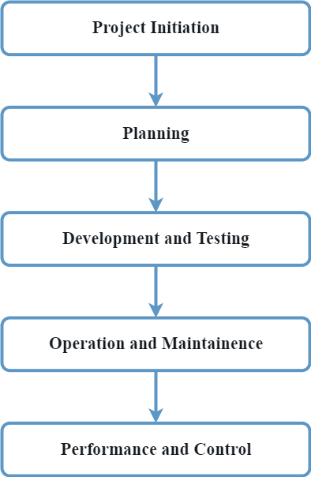
3.1 Flow Of Project

Slide 13
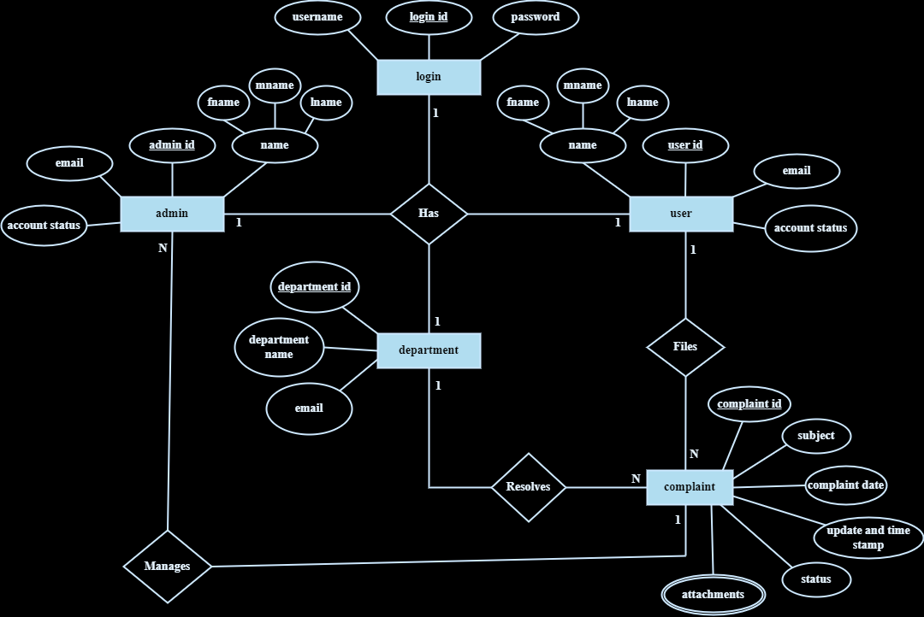
3.2 E-R Diagram

Slide 14
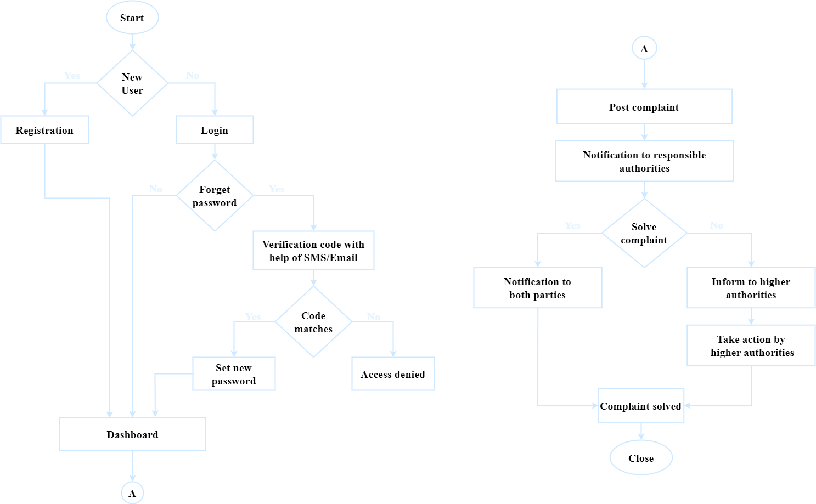
3.3 System flow
Diagram

Slide 15
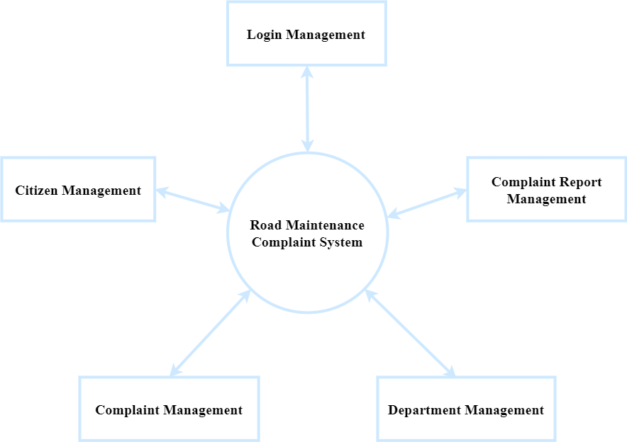
3.4 Data Flow Diagram
Level 0

Slide 16
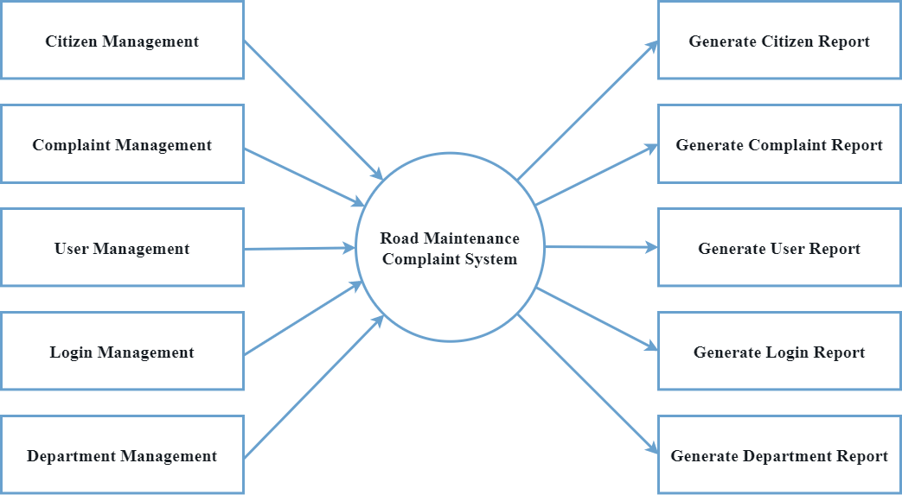
3.4 Data Flow Diagram
Level 1

Slide 17
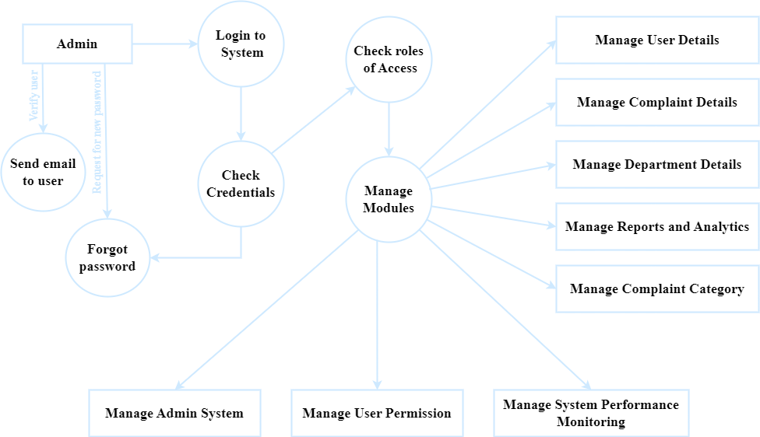
3.4 Data Flow Diagram
Level 2

Slide 18
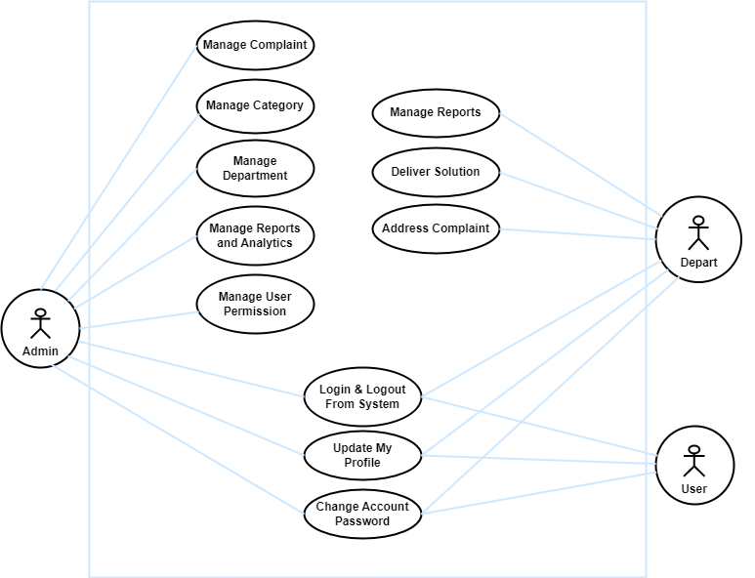
3.5 Use Case Diagram

Slide 19







Tools And Technology Used
HTML
CSS
JavaScript
PHP
MySQL
Visual Studio Code
XAMPP

Slide 20
4. Epilogue

Slide 21
Outcome
1. Efficient Issue Reporting: Provide a user-friendly platform for citizens to report road problems promptly and accurately.
2. Timely Response: Enable authorities to respond quickly to reported issues, leading to prompt repairs and maintenance.
3. Road Safety Improvement: Address problems like potholes, damaged signs, and unsafe conditions to enhance overall road safety.
4. Data Analysis: Collect and analyze data on reported issues to gain insights for decision-making and future infrastructure developments.
5. Community Engagement: Empower citizens to actively participate in road improvement efforts, fostering a sense of community involvement.

Slide 22
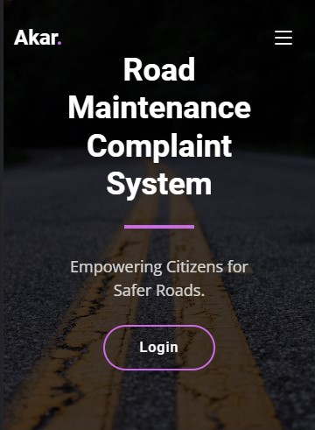
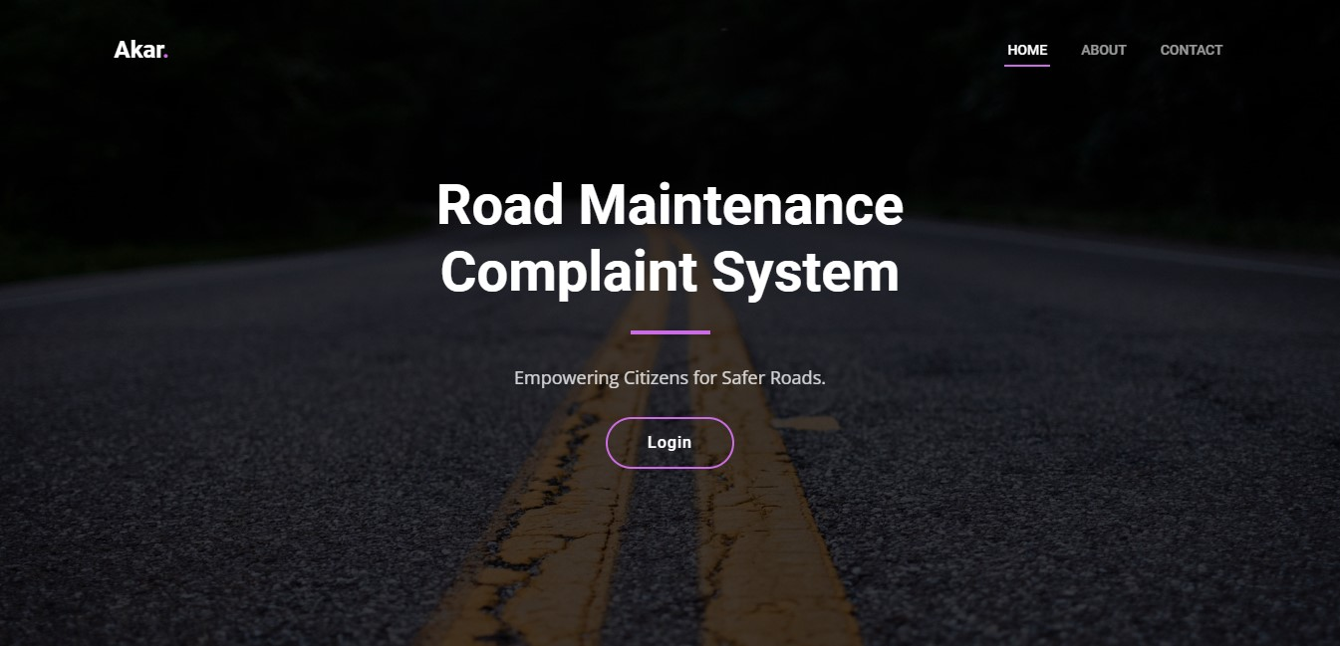
4.1 Work Completed:
User Interface Design
User-friendly mobile-responsive homepage deployed

Slide 23
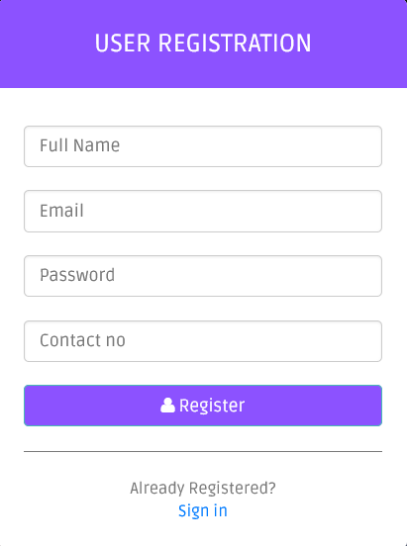
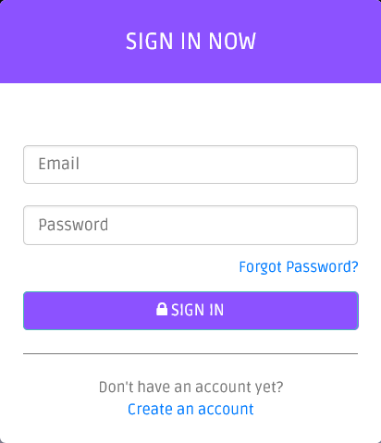
2. User Registration Module and Secure Login
Implemented user registration module and secure login for road users to create accounts and login

Slide 24
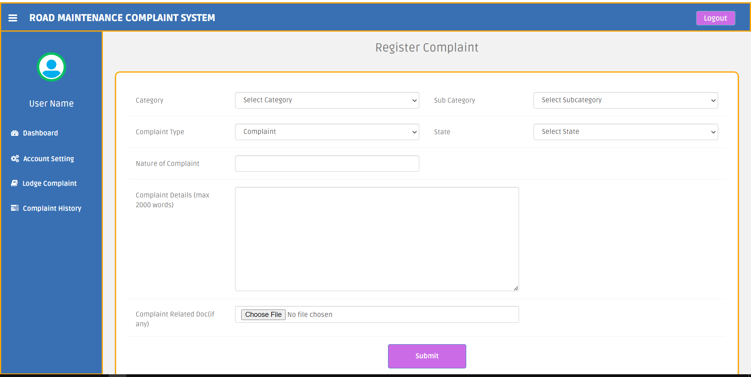
3. User Complaint Dashboard
Dashboard for users to complaint

Slide 25
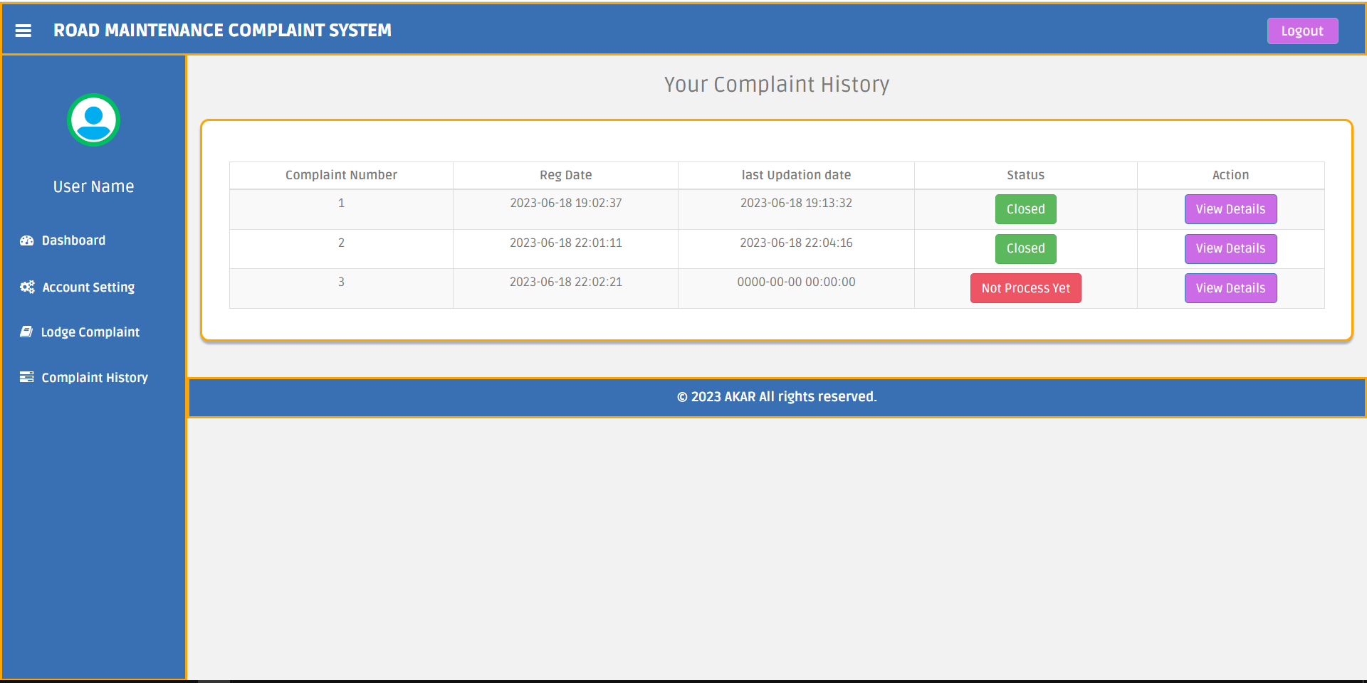
4. User Complaint History
Dashboard for users to access information, complaint status, account settings, profile, and lodge/view complaint history

Slide 26
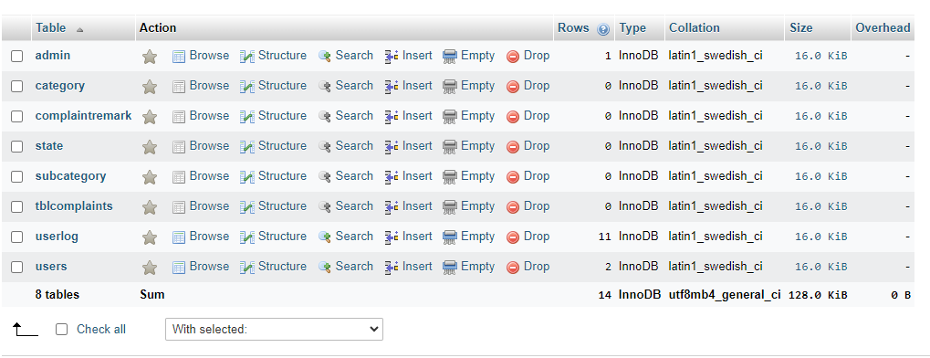
5. Database Design:
Established a comprehensive complaint database that stores and manages all reported issues

Slide 27
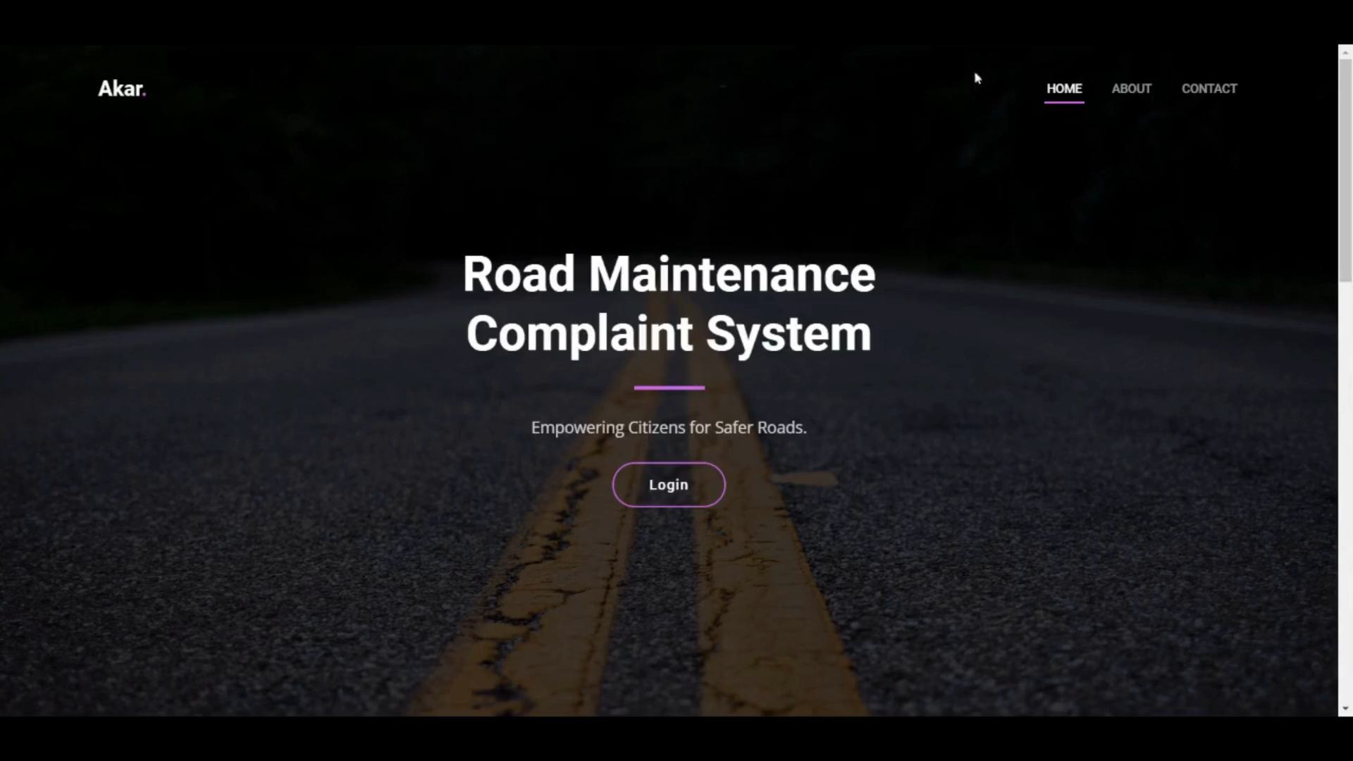
Video

Slide 28
4.2 Pending Tasks
Performance and optimization
User Authentication and Security
Complaint Tracking and Management
Collaboration with Government Authorities
Password Reset with Email Verification

Slide 29
4.3 Challenges Encountered
Spurious Complaint Submission
Scalability and Performance
Data Privacy and Security

Slide 30
5. Scope of Future Enhancement
Mobile Application Development
Real-Time Updates and Notifications
Gamification Elements
Expansion to other Geographic Areas

Slide 31
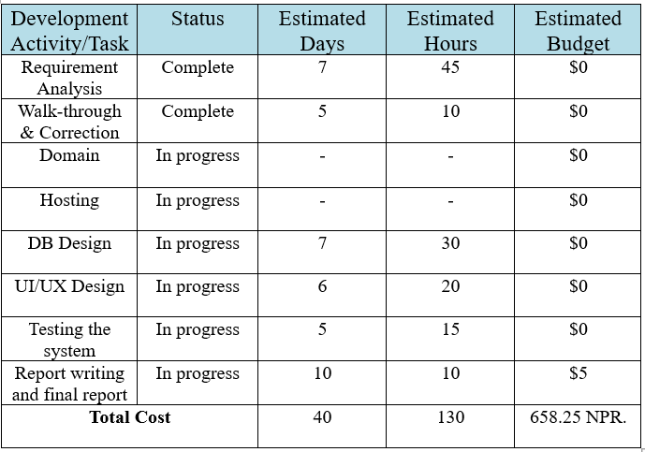
4.1 Cost Estimation

Slide 32
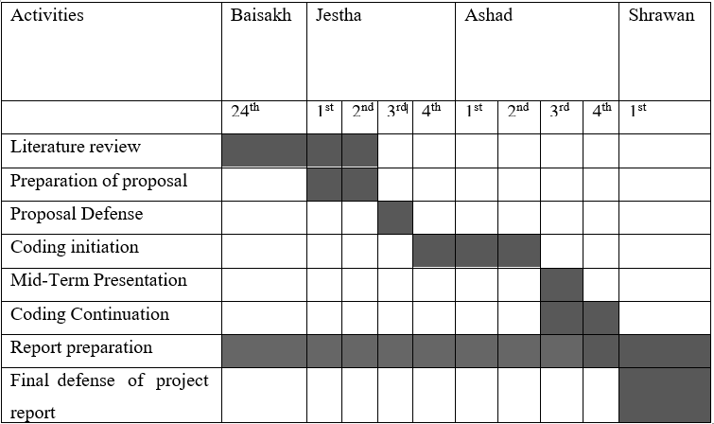
4.2 Work Schedule

Slide 33
References
[1] D. N. Chalise, "ROADS BOARD NEPAL: A SUSTAINABLE APPROACH TO ROAD MAINTENANCE MANAGEMENT," Transport and Communications Bulletin for Asia and the Pacific, vol. I, p. 81, 2005.
[2] K. Dhakal, "Road Traffic Accidents in Kathmandu Valley," Journal of Health Promotion, 2018/11/25.
[3] K. C. B. Adhikary, "Road Traffic Accident and its Characteristics in Kathmandu Valley," JNMA; journal of the Nepal Medical Association, vol. 55, 2016.
[4] E. A. Osman Nasr, "ONLINE COMPLAINT MANAGEMENT SYSTEM," International Journal of Innovative Science, Engineering & Technology, vol. II, 2015.
[5] P. Kormpho, P. Liawsomboon, N. Phongoen and S. Pongpaichet, "Smart Complaint Management System," ICT International Student Project Conference, vol. I, p. 6, 2018.
[6] King and S. F, "Fix my street or else: using the internet to voice local public service concerns," 2007.
[7]Sagar Mahurkar, Robert Vigeant, Alexander Wald, Sean Watson, "Incorporation of the Roadify API in Ride," 2015.
[8] boston.gov, "Boston," street bumps, 1 7 2019. [Online]. Available: https://www.boston.gov/transportation/street-bump. [Accessed 22 5 2023].

Slide 34
Thank you!

